Slide 1
Swift Meetup
ARC With Objects & Closures

Slide 2
Object Retain Cycles
Leak !!
Class
B
Instance
Class
A
Instance
strong
strong
Objects are deallocated when there are NO strong references left.

Slide 3
Please find that what’s wrong with following code ?
class Company {
var parent: Company?
var subsidiaries: [Company] = []
deinit { print("company instance got release from memory") }
}
do{
let tata = Company()
tata.subsidiaries = [Company(),Company(),Company()]
tata.subsidiaries.forEach { $0.parent = tata }
}

Slide 4
Strong
4
Company
tata
subsidiaries
parent
nil
Strong
Strong
Strong
Strong
Strong
Strong
1
Company
1
Company
1
Company
subsidiaries
parent
subsidiaries
parent
subsidiaries
parent

Slide 5
tata = nil
Leak !!
3
Company
subsidiaries
parent
nil
1
Company
1
Company
1
Company
subsidiaries
parent
subsidiaries
parent
subsidiaries
parent

Slide 6
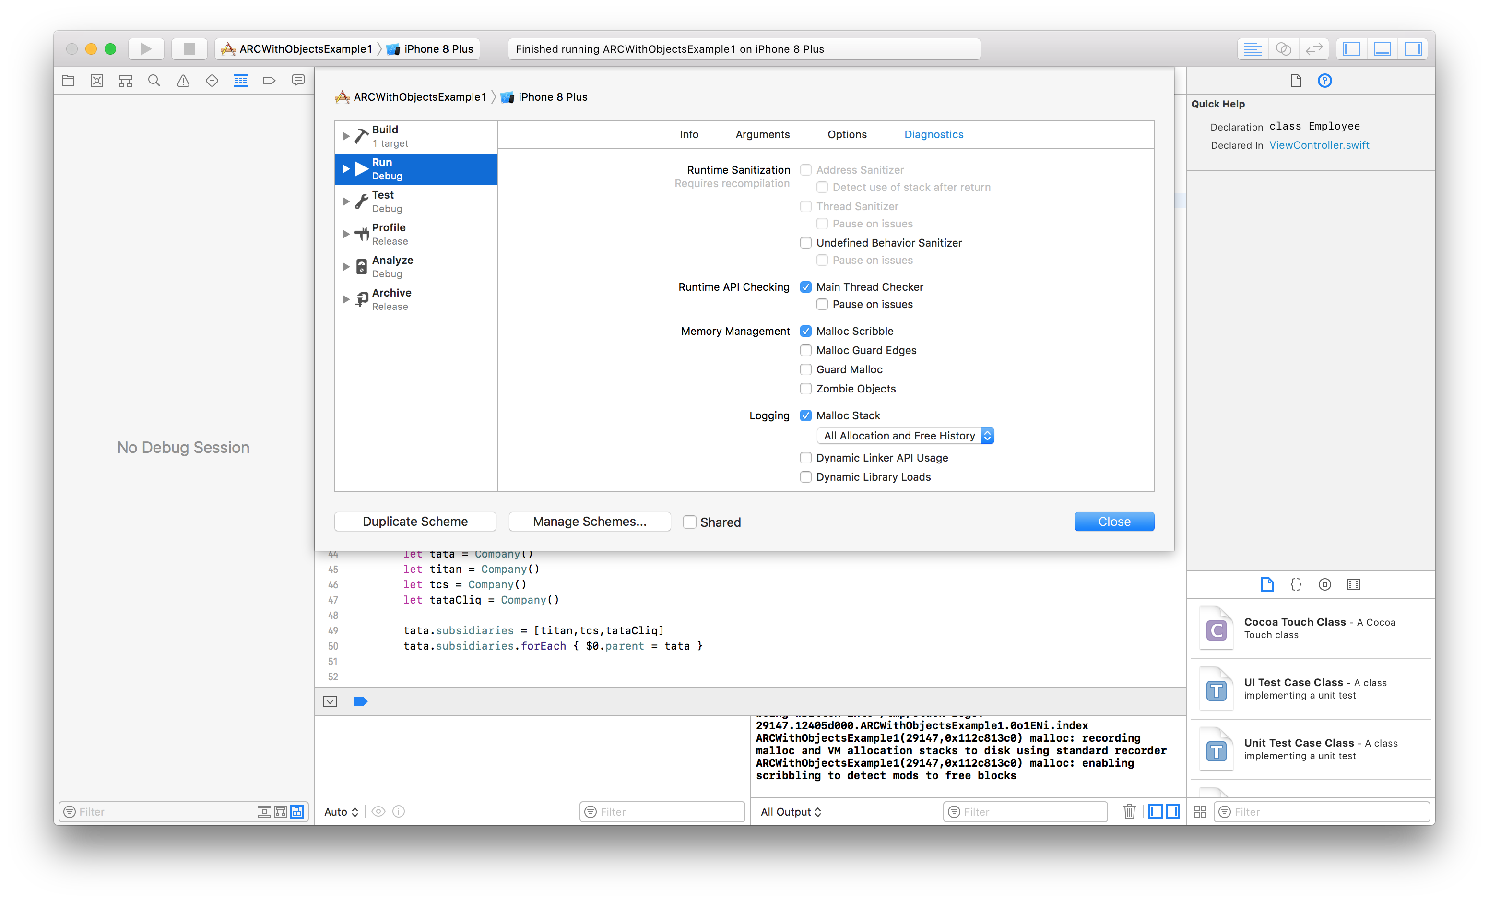
Enable Memory Graph Debugger Scheme

Slide 7
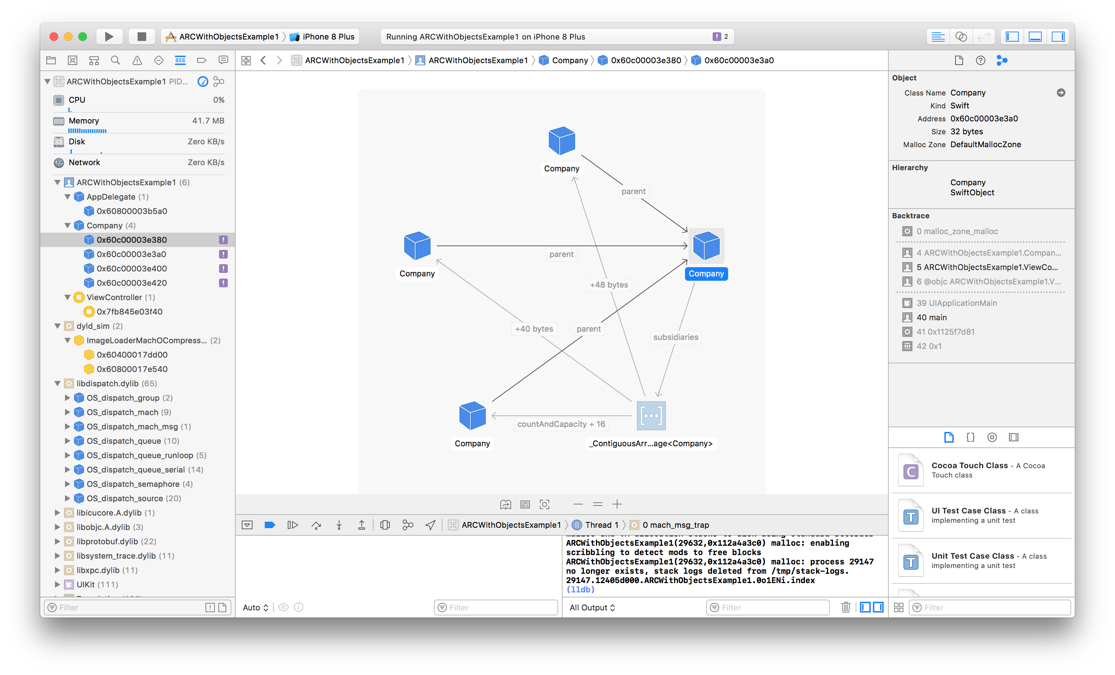

Slide 8
Solution: Use Weak to avoid reference cycle
class Company {
weak var parent: Company?
var subsidiaries: [Company] = []
deinit { print("company instance got release from memory") }
}
do{
let tata = Company()
tata.subsidiaries = [Company(),Company(),Company()]
tata.subsidiaries.forEach { $0.parent = tata }
}

Slide 9
Strong
1
Company
tata
subsidiaries
parent
nil
Strong
weak
Strong
weak
Strong
weak
1
Company
1
Company
1
Company
subsidiaries
parent
subsidiaries
parent
subsidiaries
parent

Slide 10
Please find that what’s wrong with following code ?
class Customer {
let name: String
var card: CreditCard?
init(name: String) {
self.name = name
}
deinit { print("\(name) is being deinitialized") }
}
class CreditCard {
let number: UInt64
let customer: Customer
init(number: UInt64, customer: Customer) {
self.number = number
self.customer = customer
}
deinit { print("Card #\(number) is being deinitialized") }
}
do{
var john: Customer?
john = Customer(name: "John Appleseed")
john!.card = CreditCard(number: 1234_5678_9012_3456, customer: john!)
}

Slide 11
strong

Slide 12
Leak !!
John = nil
Strong

Slide 13
Solution: Use Unowned
class Customer {
let name: String
var card: CreditCard?
init(name: String) {
self.name = name
}
deinit { print("\(name) is being deinitialized") }
}
class CreditCard {
let number: UInt64
unowned let customer: Customer
init(number: UInt64, customer: Customer) {
self.number = number
self.customer = customer
}
deinit { print("Card #\(number) is being deinitialized") }
}
do{
var john: Customer?
john = Customer(name: "John Appleseed")
john!.card = CreditCard(number: 1234_5678_9012_3456, customer: john!)
}

Slide 15
Two Flavors of Weak references in Swift : Weak and Unowned
Weak
Always used on var (optional type)
Automatically Changes itself to nil when underlying references goes away
Unowned
Always used on let(non-optional type)

Slide 16
Swift Closure Reference Cycle
Leak !!
Class
A
Instance
Closure

Slide 17
Closures are very fundamental to Swift and they are also reference type.

Slide 18

Please find that what’s wrong with following code ?
class Demo {
var value = 0
lazy var increment : (Int) -> Void = { by in
self.value += by
print(self.value)
}
}
do
{
let demo = Demo()
demo.increment(3)
}

Slide 19
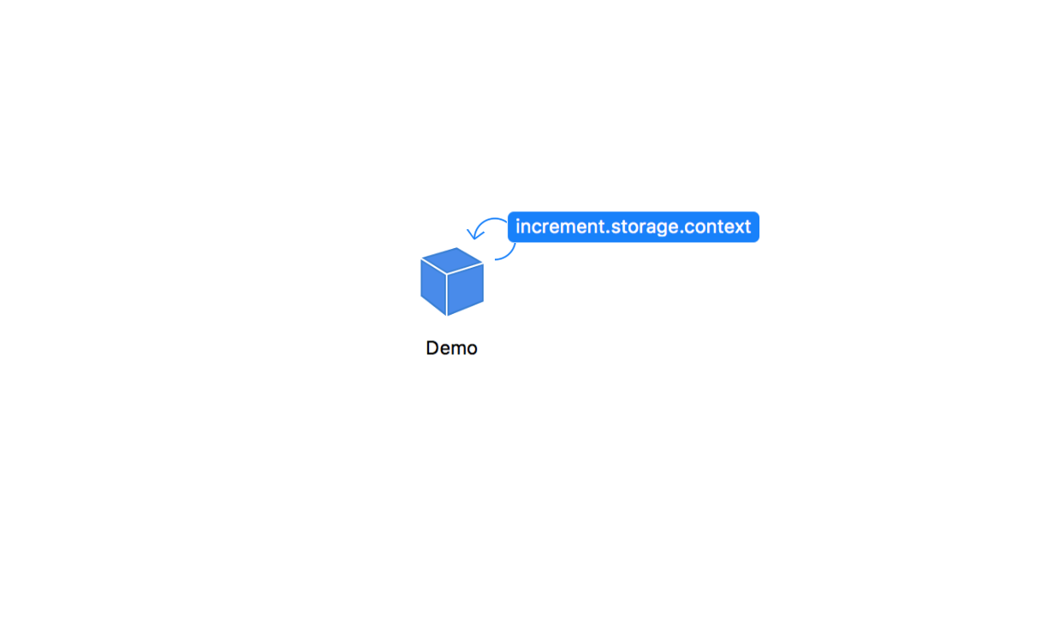
This piece of code exhibits memory leak. How?
class Demo {
var value = 0
lazy var increment : (Int) -> Void = { by in
self.value += by
print(self.value)
}
}
do
{
let demo = Demo()
demo.increment(3)
}
Leak !!

Slide 20
demo
Strong
Demo Instance
Closure
Strong
var value
self.value += by
print(self.value)
var increment : (Int) -> Void
Strong

Slide 21
Before coming to solution: Just think
What if Swift didn’t have Closures. Well We could sort of simulated Closures using a class because Classes are also reference types.
Closure closes over is a stored property, which could be simulated as stored property to that class. And Then we can have a method that operates on the stored property.
class Increment {
let demo : Demo
func invoke(by amount:Int) -> Void {
demo.value += amount
print(demo.value)
}
init(demo:Demo){
self.demo = demo
}
}
class Demo
{
var value = 0
lazy var increment : Increment =
Increment(demo: self)
}

Slide 22

class Demo
{
var value = 0
lazy var increment : Increment =
Increment(demo: self)
}
class Increment {
let demo : Demo
func invoke(by amount:Int) -> Void {
demo.value += amount
print(demo.value)
}
init(demo:Demo){
self.demo = demo
}
}
Strong
Strong
do{
let demo = Demo()
demo.increment.invoke(by: 3)
}
This exhibits memory leak!

Slide 23
class Demo
{
var value = 0
lazy var increment : Increment =
Increment(demo: self)
}
class Increment {
unowned let demo : Demo
func invoke(by amount:Int) -> Void {
demo.value += amount
print(demo.value)
}
init(demo:Demo){
self.demo = demo
}
}
Strong
unowned
Hence, memory leak will go away now!

Slide 24
There is a language feature to help breaking this reference cycle. And that is called Capture List.
class Demo {
var value = 0
lazy var increment : (Int) -> Void = { [unowned self] by in
self.value += by
print(self.value)
}
}
do
{
let demo = Demo()
demo.increment(3)
}

Slide 25
demo
Strong
Demo Instance
Closure
unowned
var value
self.value += by
print(self.value)
var increment : (Int) -> Void
Strong

Slide 26

Again, It has a problem.
class Demo {
var value = 0
lazy var increment : (Int) -> Void = { [unowned self] by in
self.value += by
print(self.value)
}
}
do
{
//let demo = Demo()
//demo.increment(3)
Demo().increment(3)
}

Slide 27
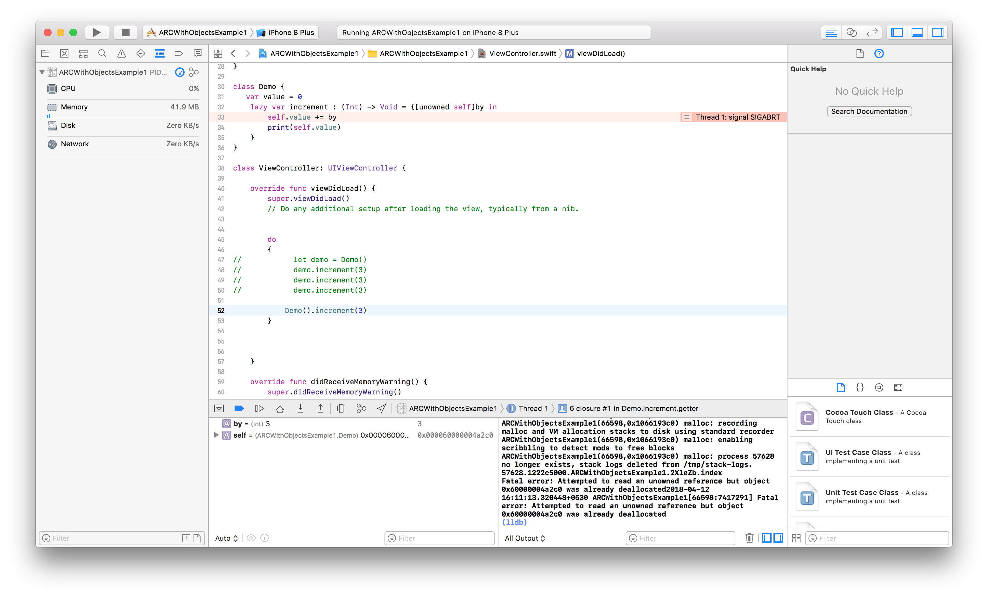

Slide 28
class Demo {
var value = 0
lazy var increment : (Int) -> Void = { [weak self] by in
guard let StrongSelf = self else
{
print("Nope")
return
}
StrongSelf.value += by
print(StrongSelf.value)
}
}
do
{
//let demo = Demo()
//demo.increment(3)
Demo().increment(3)
}
Problem is fixed.

Slide 29
If self could be nil in the closure use [weak self].
If self will never be nil in the closure use [unowned self].

Slide 30

[value]
[weak]]
[a]
{ [Capture List] }
[b]
[unowned]

Slide 31
{ [Capture List] }
class Demo {
var value = 0
lazy var increment : (Int) -> Void = {[weak self, value] by in
guard let myself = self else
{
print("Nope")
return
}
myself.value += by
print(value)
}
}
Please guess the output ?
do
{
let demo = Demo()
demo.increment(3)
demo.increment(3)
demo.increment(3)
}

Slide 32

Strong,
Weak,
Unowned
Oh My God !!

Slide 33
Unsafe Swift: Using Pointers

Slide 34
let count = 2
let pointer = UnsafeMutablePointer<Int>.allocate(capacity: count)
pointer.initialize(to: 0, count: count)
defer {
pointer.deinitialize(count: count)
pointer.deallocate(capacity: count)
}
pointer.pointee = 42
pointer.advanced(by: 1).pointee = 6
// or (pointer+1).pointee = 6
pointer.pointee
pointer.advanced(by: 1).pointee
// or (pointer+1).pointee

Slide 35

About the Speaker
Brajmohan Papneja
Masters in Computer Applications(2005-2008)
National Institute of Technology Karnataka Surathkal
Working with Allstate India

